Slide 1
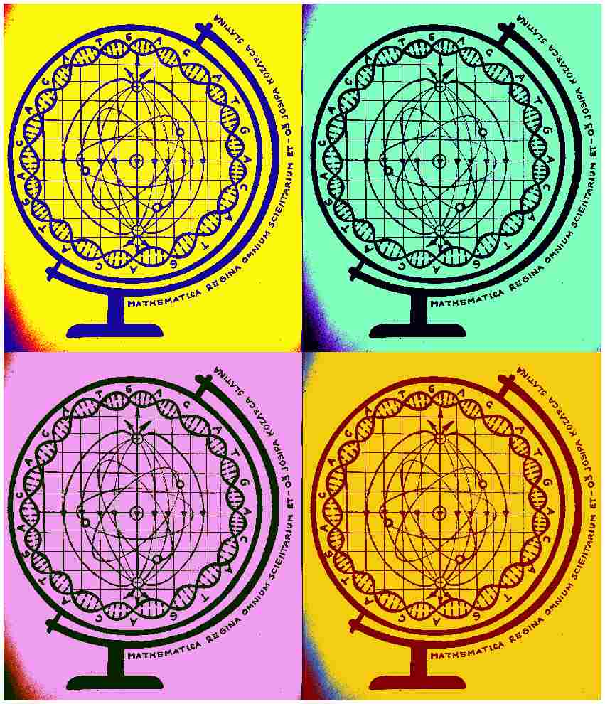
Mathematica regina omnium scientiarum et – learning path to success
WHAT CAN BE SEEN WHEN THE NIC DOES NOT SEE?
Activity for Decemeber 2018.

Slide 2
ONLY IN THE DARKNESS YOU CAN SEE THE STARS

Slide 3
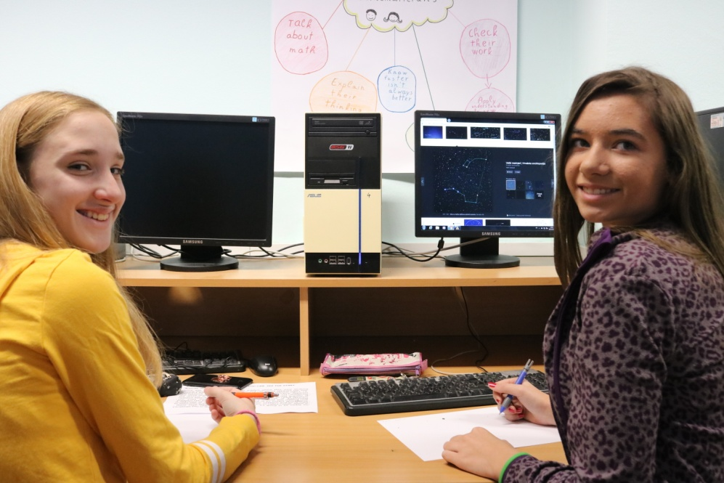
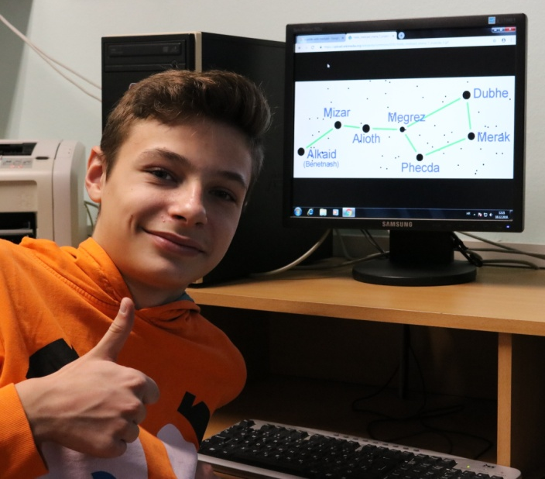
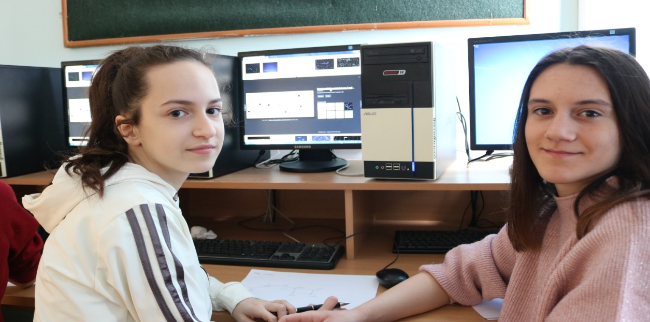

Slide 4
Activity description:
There was a workshop among 7th graders where they were studying
shining stars in individual constellation and calculating apparent star size.
Apparent star size is a quantitative size of a glowing celestial object, i.e.
the measure of brightness which it creates on Earth surface. Apparent
star shine describes how much the star shines in the sky, not considering
the reasons of its strong or weak glow,i.e. distance or real quantity of
radiated light. Apparent (observed) glow expresses in, so called apparent
star sizes magnitudes-m. There are more methods of determining
apparent star size, and we picked Argalander's method. This method uses
a sequence of neighboring stars that depend of an instant glow. We've
studied star in constellation : Great Bear, Orion, Cepheus and we've tried
to determine apparent size of a comet Wirtanen, so called Comet, which is, these days, visible to the naked eye and it's going to be visible on
Christmas Day in the evening.

Slide 5
Inspiration for this activity comes from the fact that astronomy:
-is one of the oldest sciences made from primary human activities and practical needs
-has got a long history in Croatia since 12th century and series of discoveries and Getald's discovery of binoculars and Bošković's geometrically determining of comet's path are just some of them
-favorite science among children because of practical use and amateurs, still has a special part in discovering and watching celestial phenomena
-related to Mathematics

Slide 6
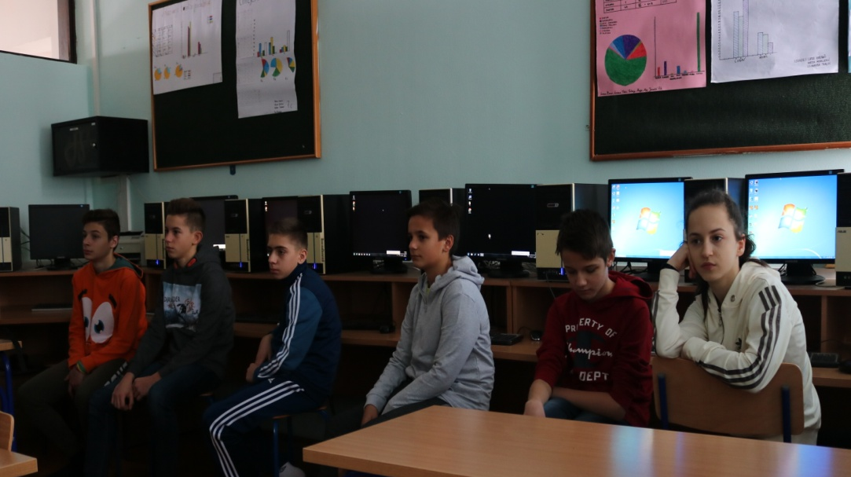
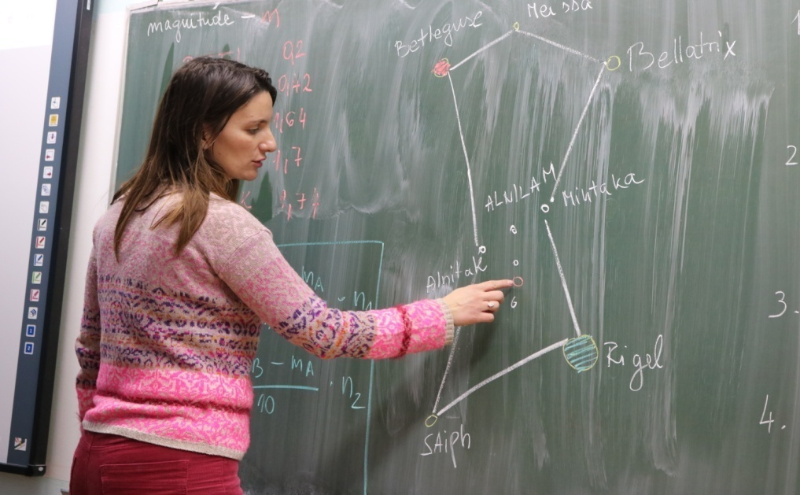

Slide 7
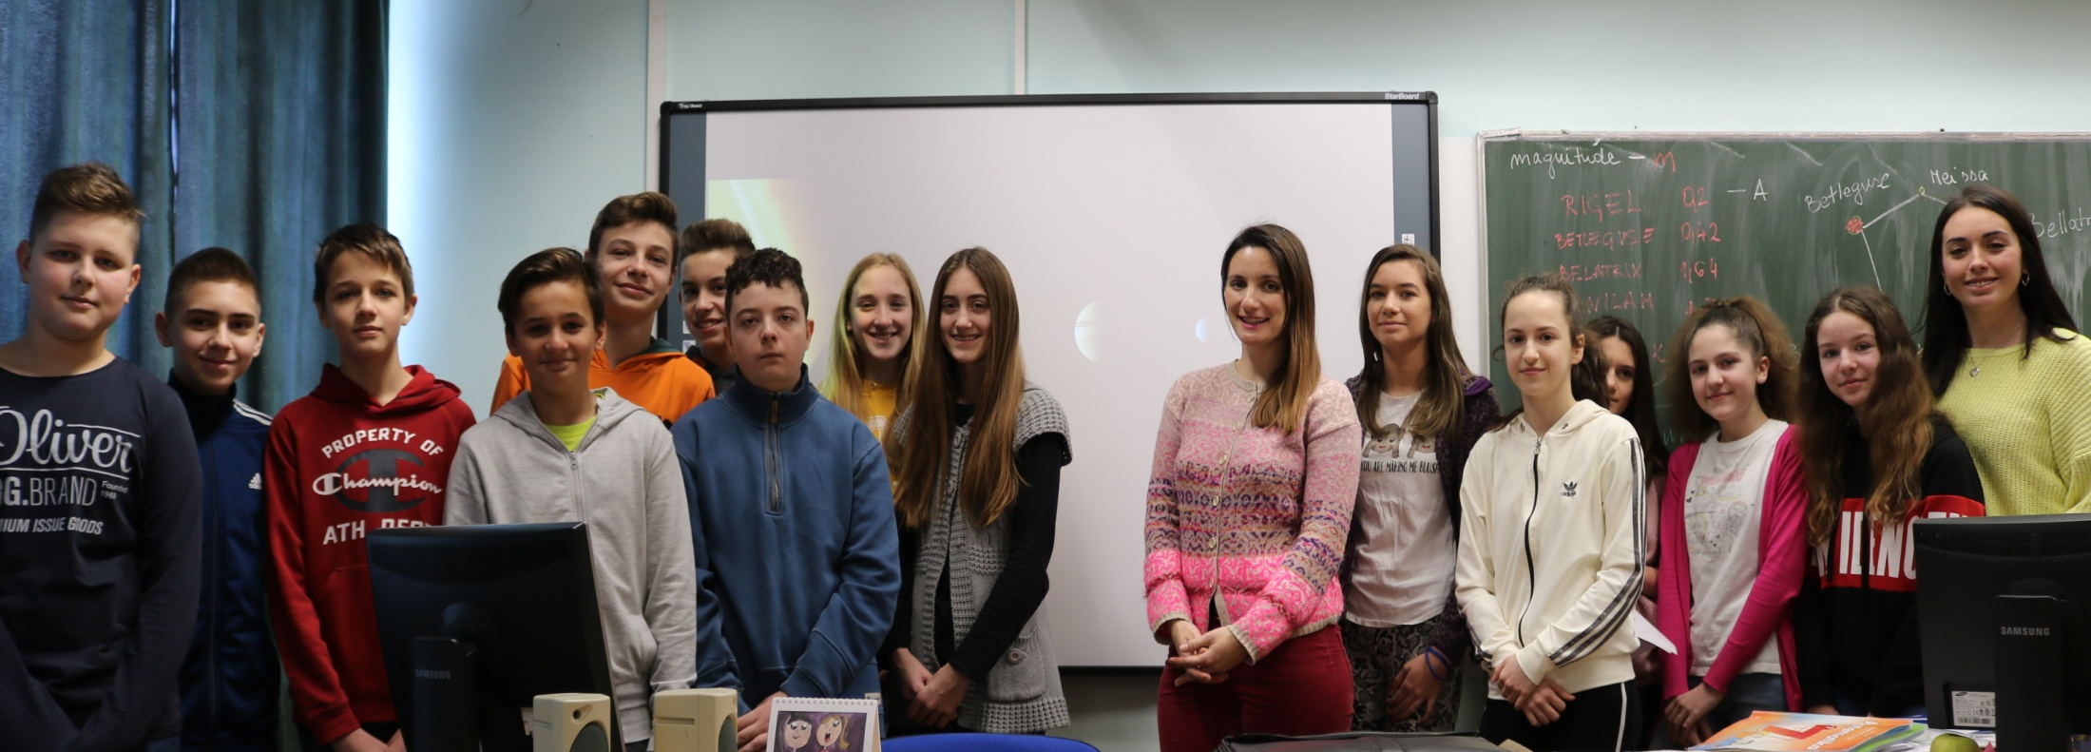
Activity Aim
-to connect astronomy and mathematics with Christmas theme
-popularization of astronomy and similar sciences

Slide 8
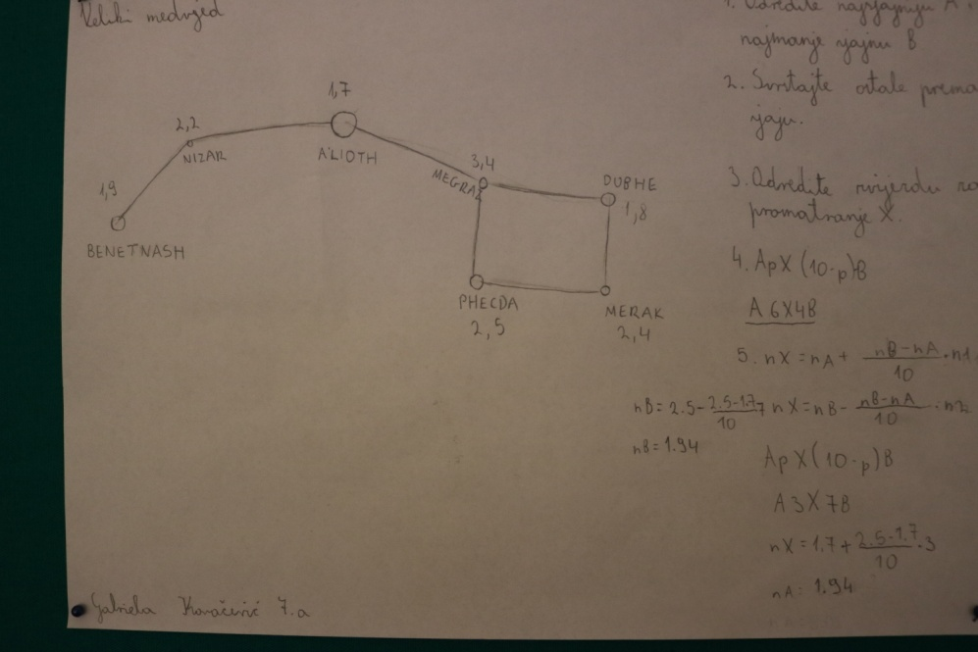
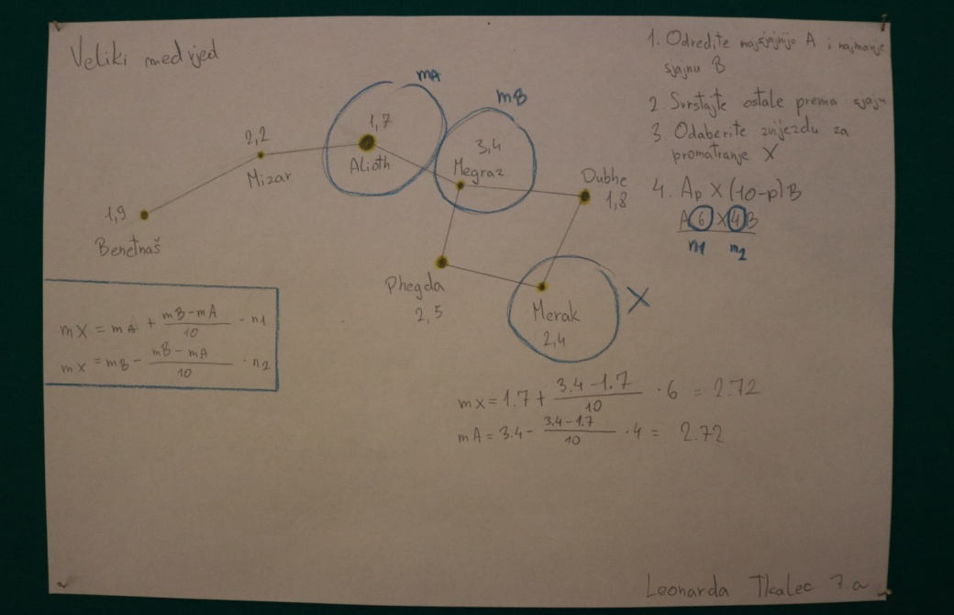

Slide 10
Additionally:
The activity is accompanied by making a short film in English which will be released on a transnational meeting in Portugal in May 2019. In purpose of making this kind of a film, the activity is translated in English and leading actors are students who present their knowledge through the activity. For documenting the activity we are going to use multimedia equipment, photo camera, camera, internet, Youtube channel and Adobe Premiere Pro program.
The activity is created and accomplished by
Math teacher Anita Jukić
and Physics teacher Martina Bukvić
in cooperation with
English teacher Azra Benković.

