Slide 1
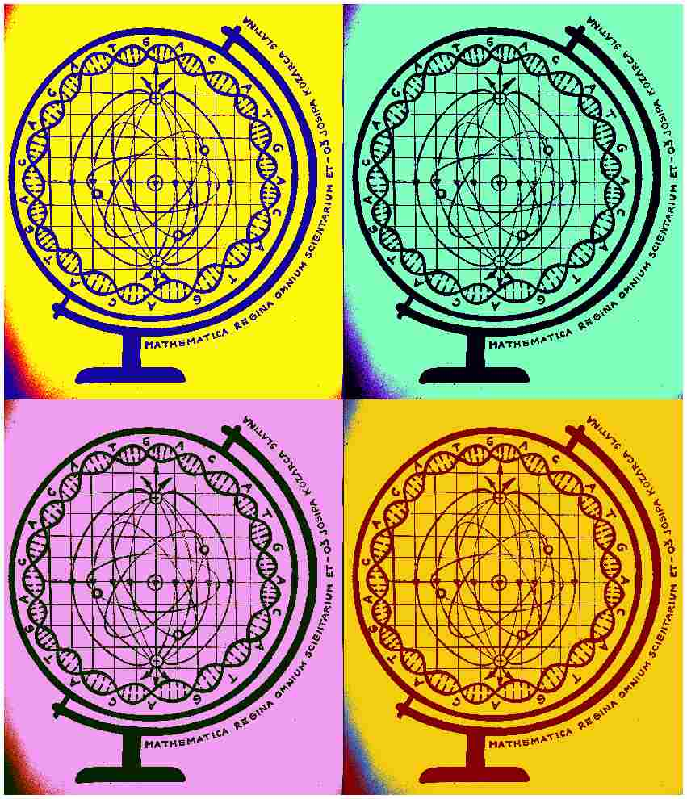
Mathematica regina omnium scientiarum et – learning path to success
How is it working?
Activity for September/October 2019.

Slide 2
Bicycle-powered Christmas tree
In the plan and program of the project it is advised that students learn how man can overcome the laws of physics.

Slide 3
Description of the activity
In the first part of the workshop, we connected a dynamo to the bicycle and then the Christmas lights. Students had to calculate the voltage that the dynamo would make upfront so that they would know which Christmas lights to choose from. Maximum voltage we got was 12V.

Slide 4
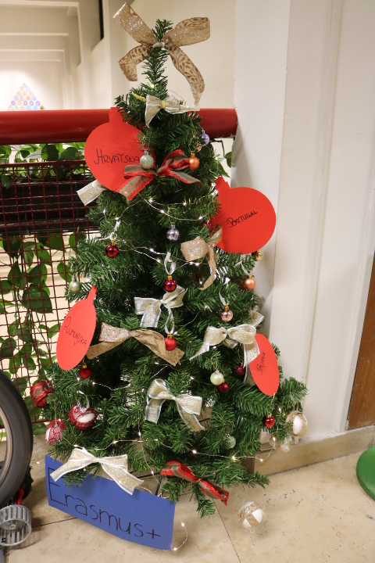
Second part of the workshop was reserved for making of Christmas tree ornaments. Our Christmas tree was decorated not only with Christmas lights but also with inventive handmade ornaments and those that stood out especially are the ones with the names of our partner countries and the Erasmus + sign.

Slide 5
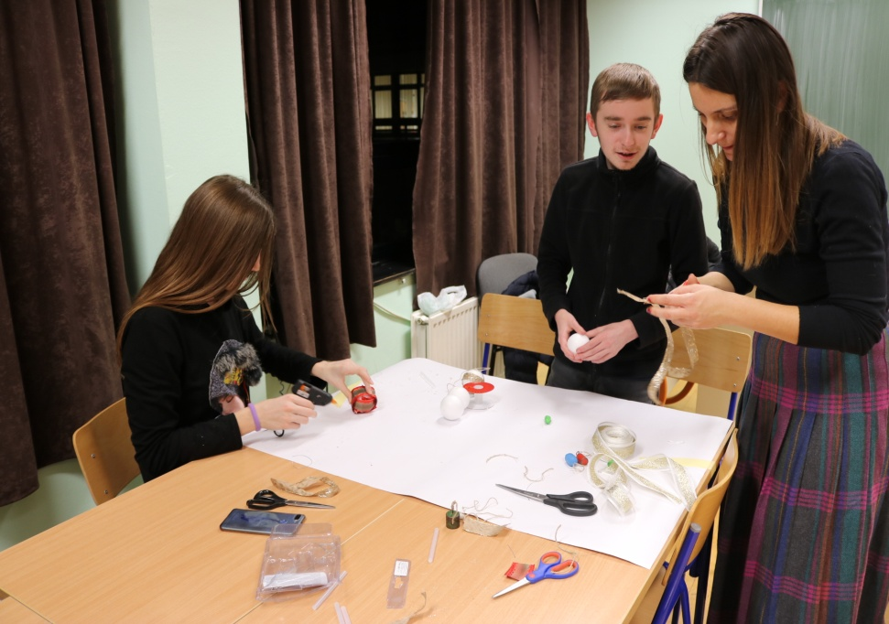
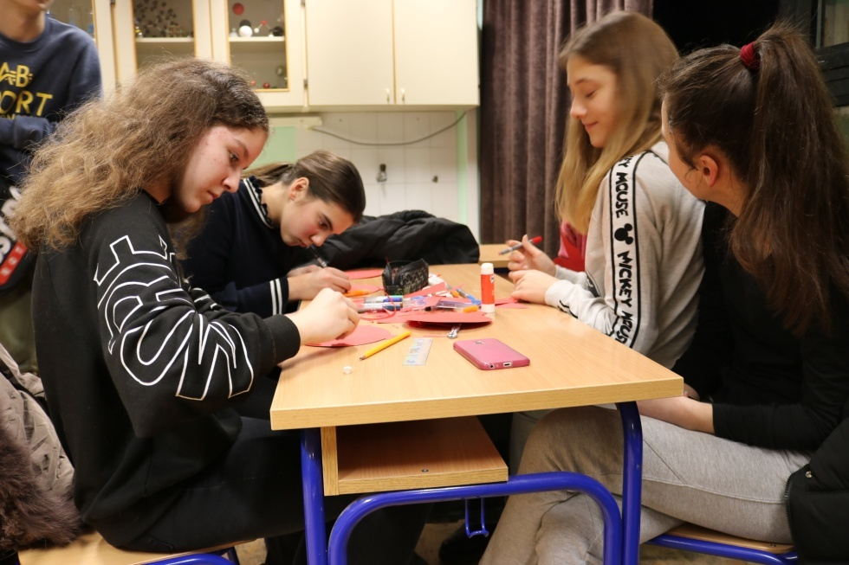

Slide 6
Motivation for the activity comes out of the fact that even though Christmas lights are beautiful, they cause massive and wasteful use of electric energy. We wanted to make beautiful Christmas lights light up by being ecologically responsible at the same time.
Aim of the activity: starting up the dynamo with the cyclic power of the legs which would then produce enough power to make the Christmas lights light up on the Christmas tree.

Slide 7
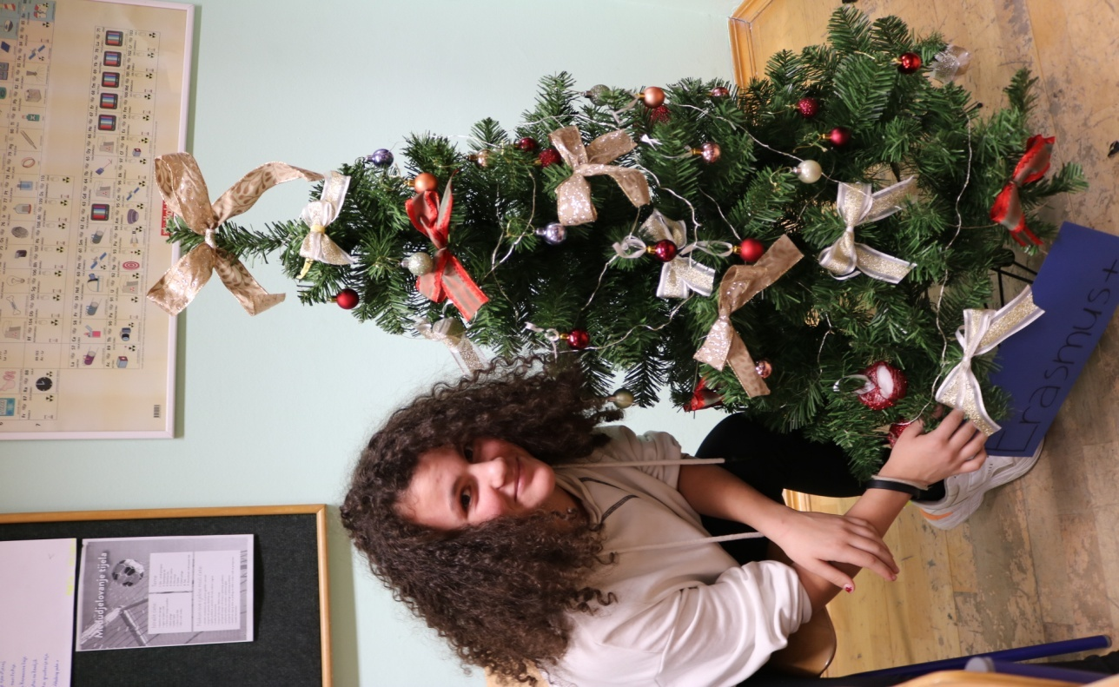
Modern methods: students’ handcrafts
Aims of learning: students will be able to apply their knowledge as to what it takes to connect the lights and make them light up stronger and more efficient.
Result of the activity: the Christmas tree would light up when the pedals of the bicycle move
Evaluation of the activity: method of conversation

Slide 8
The activity is created and accomplished by Physics teachers Martina Bukvić and Tijana Cvjetković in cooperation with Math teacher Anita Jukić and English teacher Dražena Vujanović.

